Slide 1
Binary Numbers For Beginners Using MSP430G2 LaunchPad & Texas Instrument Booster Pack
By: Recarldo Brown

Slide 2
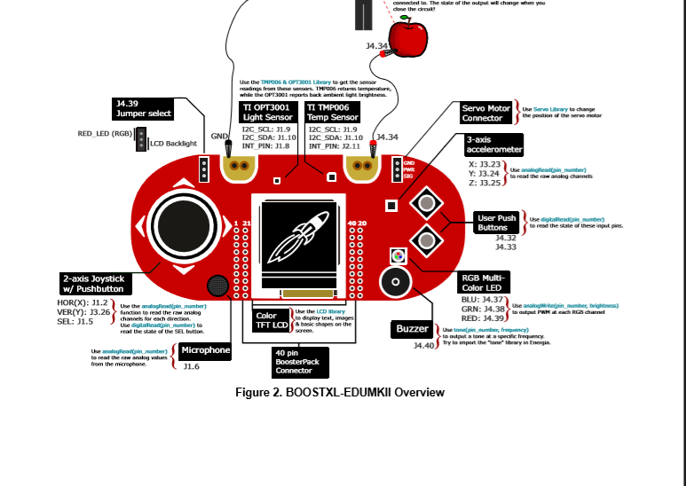

Slide 3
LED LAYOUT
0 = Unlit
1= Lit
Binary Sequence
0 = Unlit Unlit Unlit
1 = Unlit Unlit Lit
2 = Unlit Lit Unlit
3 = Unlit Lit Lit
4 = Lit Unlit Unlit
5 = Lit Unlit Lit
6 = Lit Lit Unlit

Slide 4
Values of voltage with the analog control
3.5
0.0
1.7
3.5
0.0

Slide 5
Challenges
Coding
X and Y being unable be inputted and detected at the same time by the MSP430G2 Launch Pad.

